Slide 1
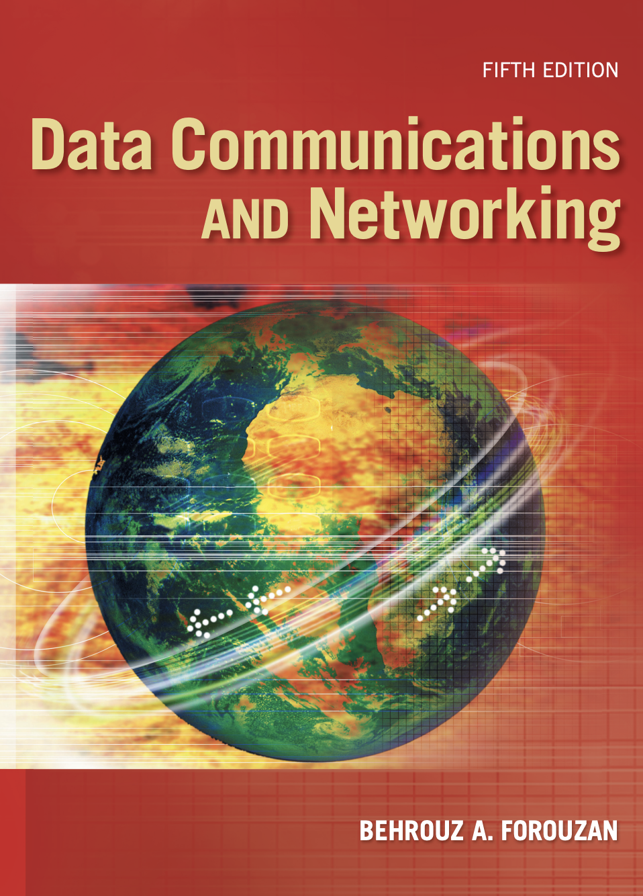
Chapter 1
Introduction

Slide 2
1.1 DATA COMMUNICATIONS
The word data refers to information presented in whatever form is agreed upon by the parties creating and using the data. Data communications are the exchange of data between two devices via some form of transmission medium such as a wire cable.
Topics discussed in this section:
Components
Data Representation Data Flow

Slide 3
Fundamental Characteristics
The effectiveness of a data communication system depends on four fundamental characteristics
Delivery
must deliver data to the correct destination.
only to the intended device or user.
Accuracy
must deliver data accurately.
Timeliness
must deliver data in a timely manner.
Jitter
refers to the variation in the packet arrival time.

Slide 4
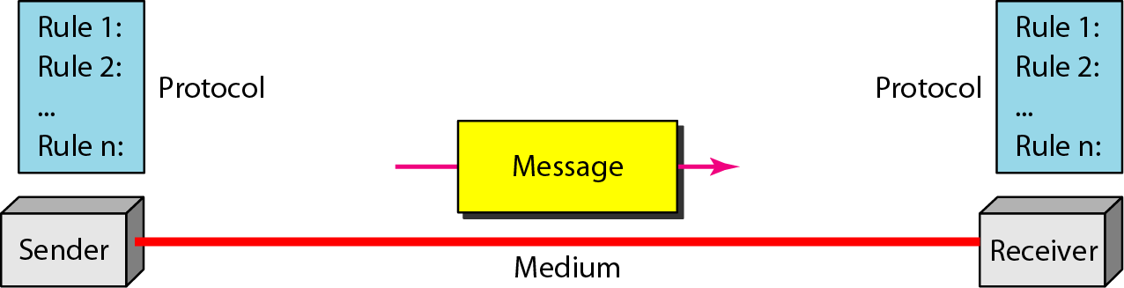
Data communications system components
Figure 1.1 Five components of data communication

Slide 5
Data communication system components (cont’d)
Message
is the information(data) to be communicated.
(text, numbers, pictures, sound, video or any combination of these)
Sender
is the device that sends the data message.
(computer, workstation, telephone handset, video camera)
Receiver
is the device that receives the message.
(computer, workstation, telephone handset, video camera)

Slide 6
Data communication system components (cont’d)
Medium
is the physically path by which a message travels from sender to receiver.
(twisted pair wire, coaxial cable, fiber- optic cable, laser , or radio waves(terrestrial or satellite microwave))
Protocol
is a set of rules that govern data communication.

Slide 7
Data Representation
Text is represented as a bit pattern.
Code : Each sets of bit patterns to represent text symbols.
ASCII : by ANSI, 7bits
Extended ASCII: 8bits
Unicode : 16 bits
ISO : 32bits
Numbers : also represented by bit patterns.
Images : also represented by bit patterns. (Picture)
Audio : It is continuous, not discrete. (Voice or music)
Video : The recording or broadcasting of a picture or movie.

Slide 8
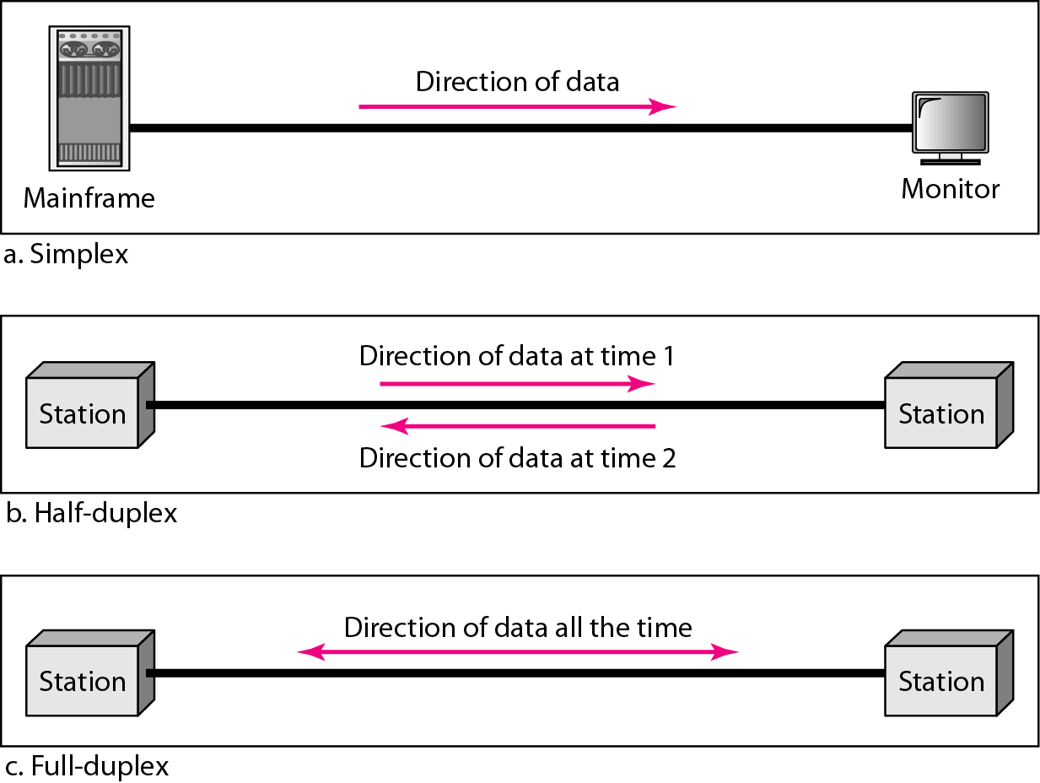
Direction of Data Flow
Figure 1.2 Data flow (simplex, half-duplex, and full-duplex)

Slide 9
Direction of Data Flow (cont’d)
Simplex
unidirectional, as on a one-way street (keyboard, monitor)
Half-Duplex
each station can both transmit and receive, but not at the same time
Full-Duplex
both stations can transmit and receive simultaneously

Slide 10
1.2 NETWORKS
A network is a set of devices (often referred to as nodes) connected by communication links. A node can be a computer, printer, or any other device capable of sending and/or receiving data generated by other nodes on the network.
Topics discussed in this section:
Network Criteria Physical Structures Network Models Categories of Networks Interconnection of Networks: Internetwork

Slide 11
Network Criteria
Network Criteria
Performance
Reliability
Security

Slide 12
Performance
Depends on several factors.
number of users
type of transmission medium
capability of hardware(s)
efficiency of software
Evaluated by two networking metrics:
Throughput and Delay.

Slide 13
Reliability
Frequency of failure
Recovery time of a network after a failure
Robustness of Catastrophe
Networks must be protected from catastrophic events such as fire, earthquake, or theft.

Slide 14
Security
Protection against unauthorized access
Protection from damage of data
Policies and procedure for recovery from breaches and data losses.

Slide 15
Physical Structures
Type of Network Connection
Point-to-Point
provides a dedicated link between two devices.
Multipoint : multi-drop
is configuration in which more than two specific devices share a single link

Slide 16
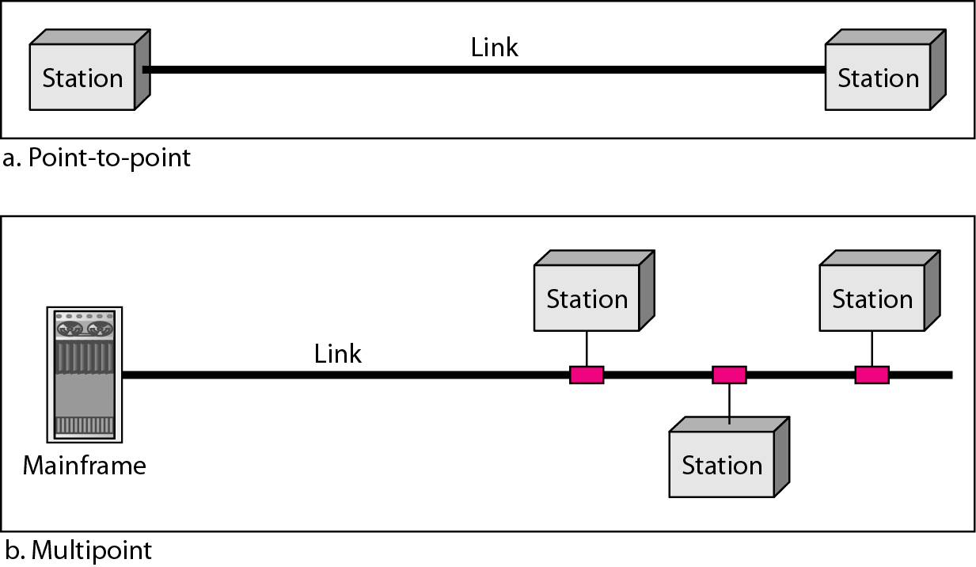
Physical Structures (cont’d)
Figure 1.3 Types of connections: point-to-point and multipoint

Slide 17
Physical Topology
Topology
Mesh
Star
Ring
Bus

Slide 18
Mesh Topology
Mesh
Every device has a dedicated point-to-point link to every other device.
A fully connected mesh network therefore has
n(n-1)/2 physical channels to link n devices.

Slide 19
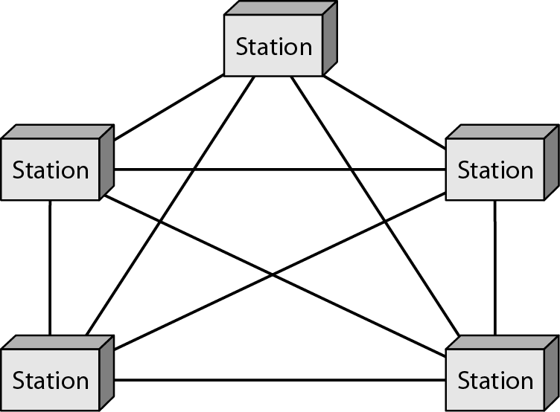
Mesh Topology (cont’d)

Slide 20
Mesh Topology (cont’d)
Advantages
Dedicated links guarantees that each connection can carry its data load.
Mesh topology is robust.
Privacy and security.
Point-to-point links make fault identification and fault isolation easy.

Slide 21
Mesh Topology (cont’d)
Disadvantages:
because every device must be connected to every other device, installation and reconfiguration are difficult.
the sheer bulk of the wiring can be greater than the available space(in walls, ceiling, or floors) can accommodate
the hardware required to connect each link (I/O port and cable) can be prohibitively expensive

Slide 22
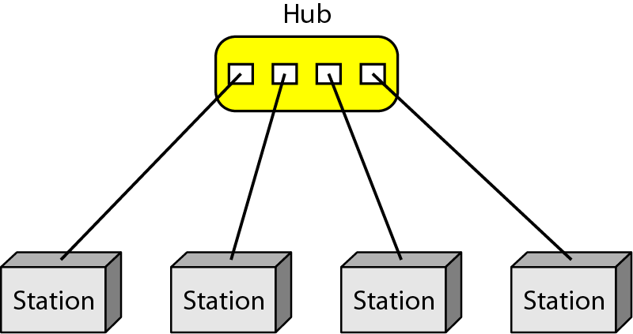
Star Topology
A dedicated point-to-point link only to a central controller, usually called a hub.

Slide 23
Star Topology (cont’d)
Advantage
Each device needs only one link and one I/O port to connect it to any number of others (easy to install and reconfigure)
Robustness
if one link fails, only that link is affected

Slide 24
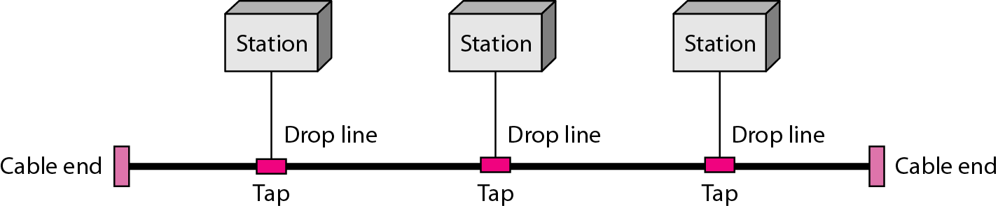
Bus Topology
One long cable acts as a backbone to link all the devices in the network using multipoint connection.
Nodes are connected to the bus cable by drop lines and taps
Drop line
is a connection running between the device and the main cable
Tap
is a connector either splices into the main cable or punctures the sheathing of a cable to create a contact with the metallic core

Slide 25
Bus Topology (cont’d)
Advantages
include ease of installation
Disadvantages
include difficult reconfiguration and fault isolation

Slide 26
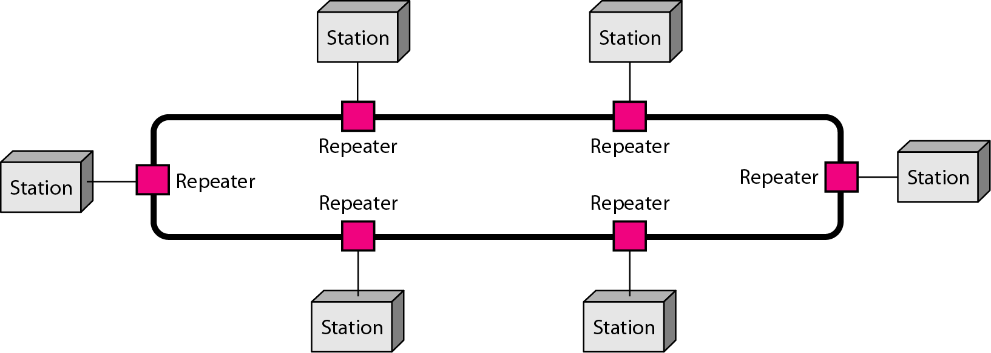
Ring Topology
Each device has a dedicated point-to-point line configuration only with the two devices on either side of it
Advantage
is relatively easy to install and reconfigure
fault isolation is simplified
Disadvantage
unidirectional traffic
break in the ring can disable the entire network
dual ring resolve the issue

Slide 27
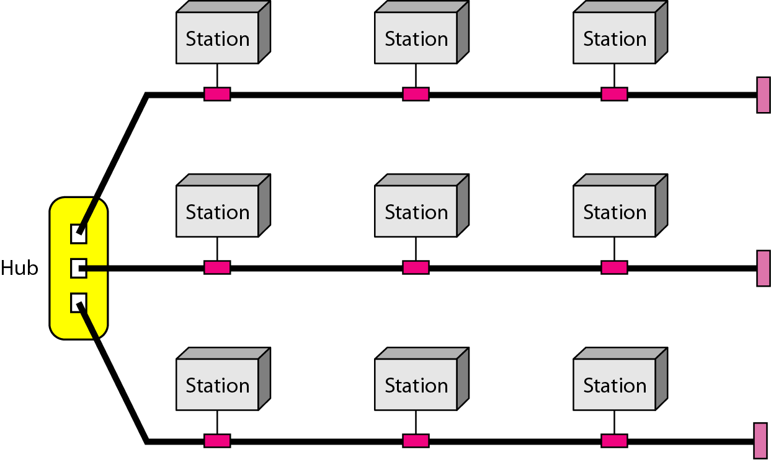
Hybrid Topology
A network can be hybrid which entails the presence of different topology.
For example, a main star topology with each branch connecting several stations in a bus topology.

Slide 28
Categories of Networks
Three primary categories
size, ownership, distance it cover, physical architecture
Network
Types
Local Area Network (LAN)
Metropolitan Area Network (MAN)
Wide Area Network (WAN)

Slide 29
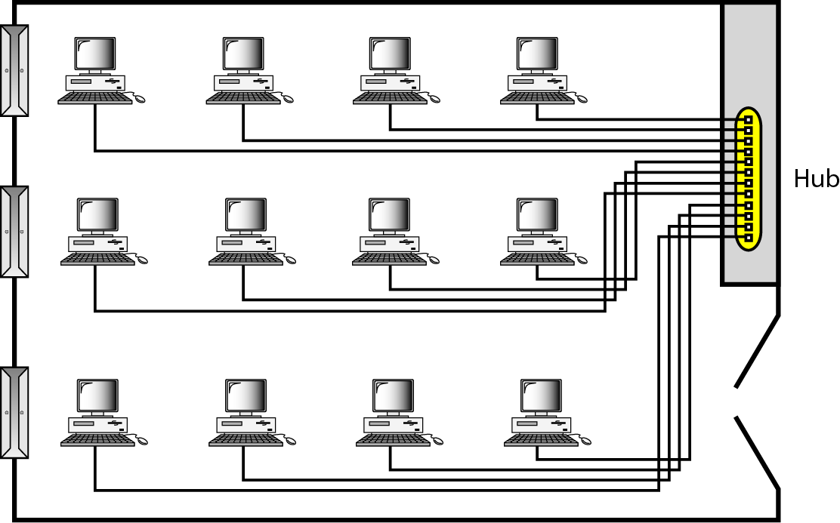
Local Area Networks (LAN)
Usually privately owned and links the devices in a single office, building or campus
Figure 1.10 An isolated LAN connecting 12 computers to a hub in a closet

Slide 30
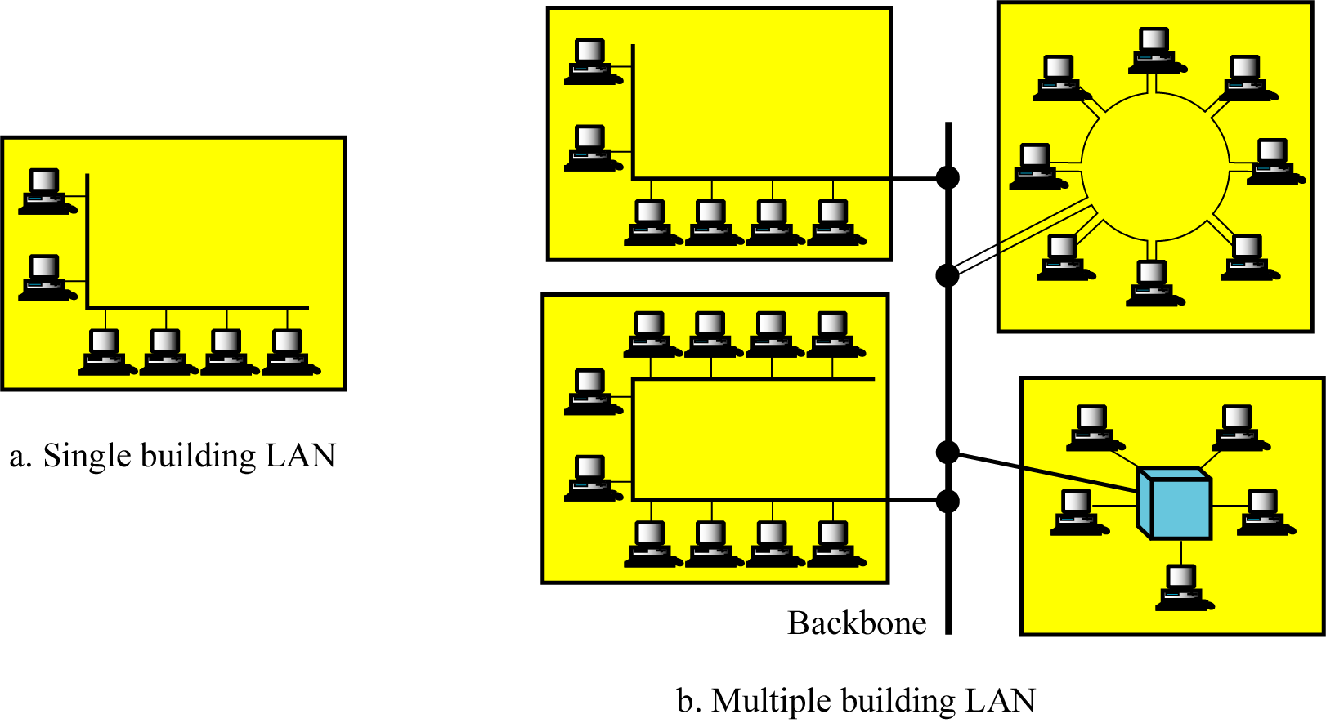
Local Area Networks (LAN) (Cont’d)

Slide 31
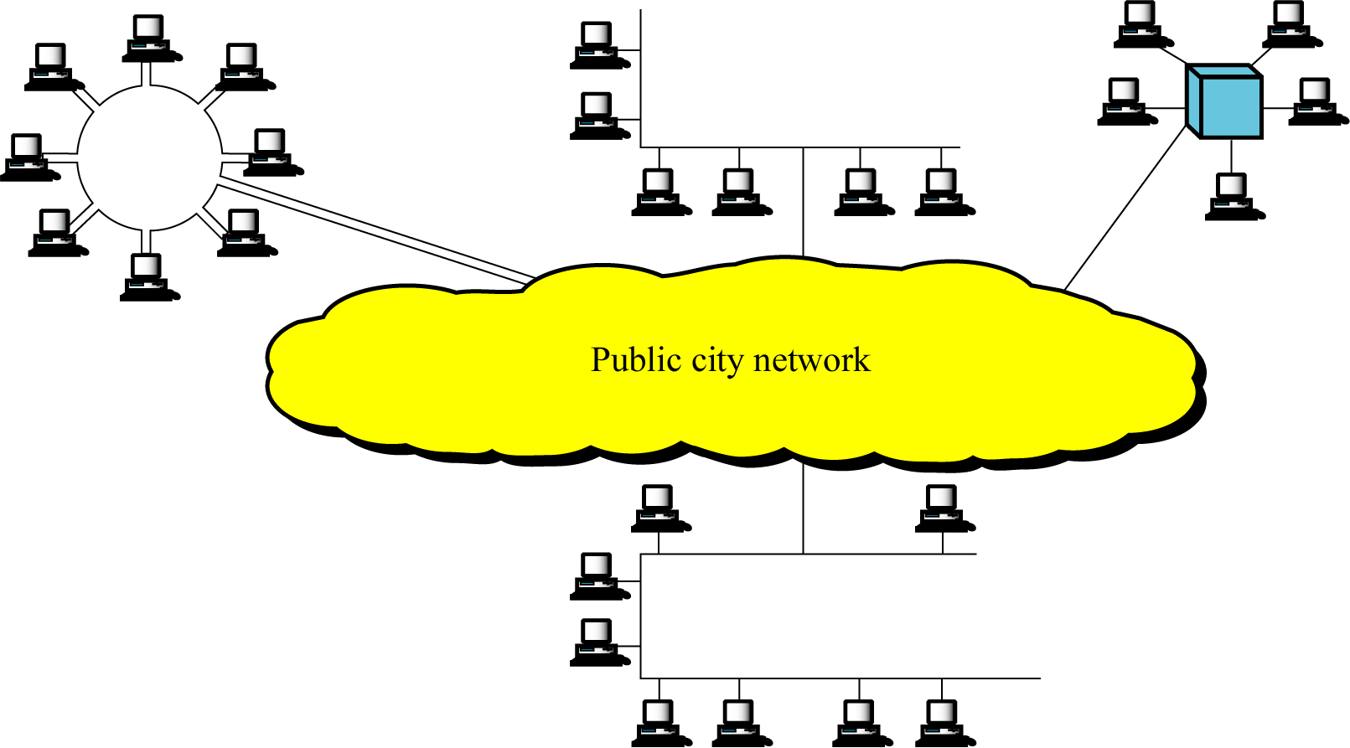
Metropolitan Area Network (MAN)
MAN is designed to extend over an entire city

Slide 32
Wide Area networks (WAN)
WAN provides long-distance transmission of data, voice, image, and video information over large geographical areas that may comprise a country, a continent, or even the whole world

Slide 33
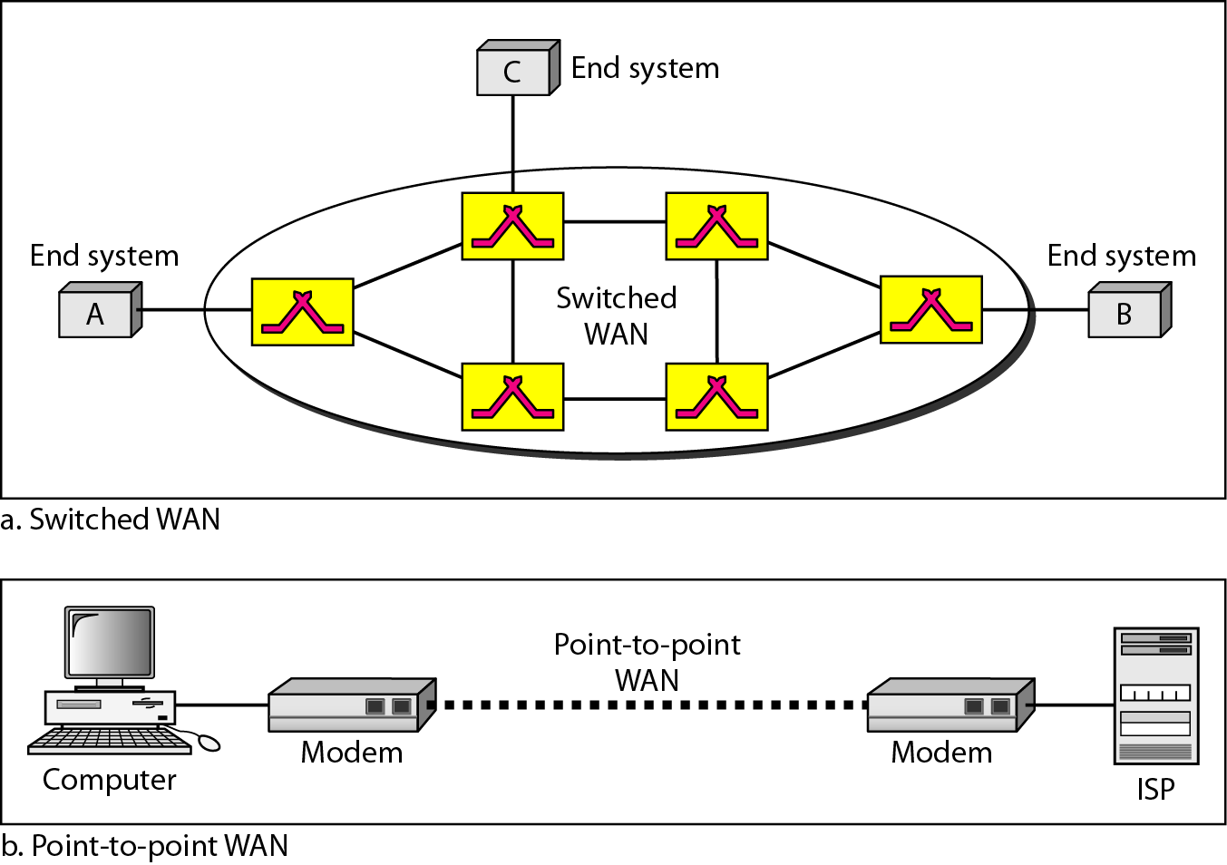
Categories of Networks (cont’d)
Figure 1.11 WANs: a switched WAN and a point-to-point WAN

Slide 34
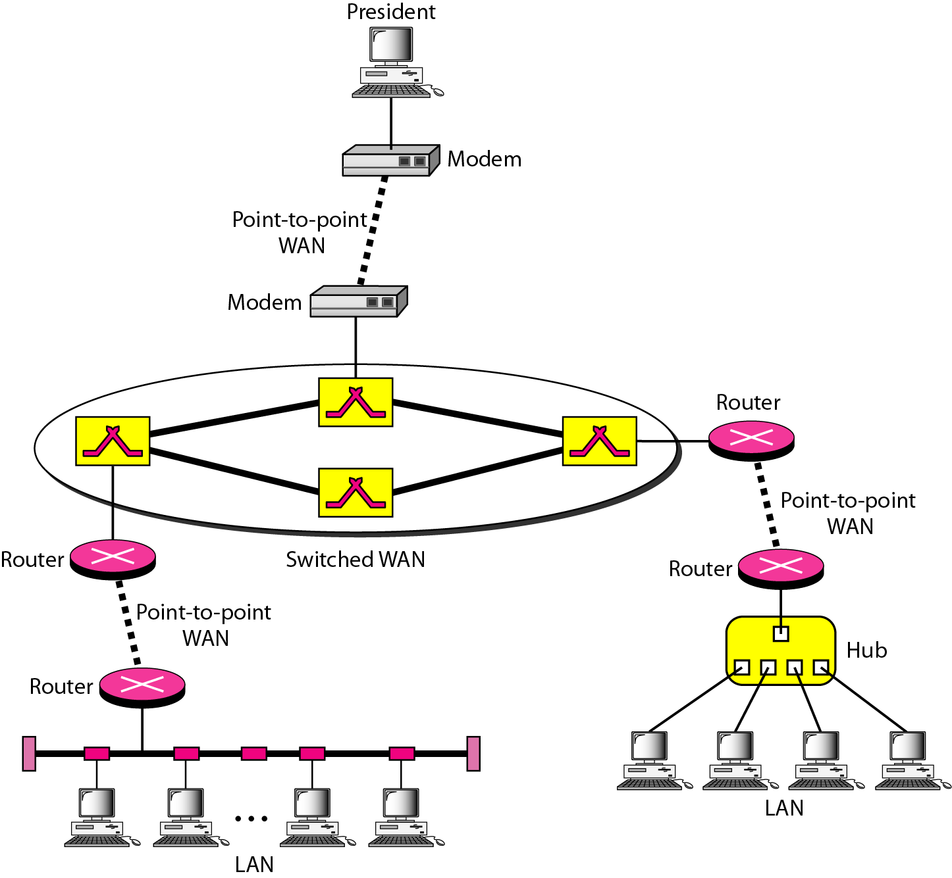
Interconnection of Networks : Internetwork
Two or more networks are connected; they become an internet.
Figure 1.12 A heterogeneous network made of four WANs and two LANs

Slide 35
1.3 THE INTERNET
The Internet has revolutionized many aspects of our daily lives. It has affected the way we do business as well as the way we spend our leisure time. The Internet is a communication system that has brought a wealth of information to our fingertips and organized it for our use.
Topics discussed in this section:
A Brief History
The Internet Today (ISPs)

Slide 36
Internet
A Brief History
Internet (not internet)
ARPANET (Advanced Research Projects Agency: ARPA) – mid-1960s
Advanced Research Projects Agency (ARPA) in the DOD : presented ideas of ARPANET, 1967
Reality : 1969 (UCLA, UCSB, SRI, U of Utah)
Birth of Internet : in 1972
Vint Cerf and Bob Kahn : Internetting Project
TCP/IP : A paper by Cerf and Kahn in 1973
In 1983, TCP/IP became to official protocol for the ARPANET
MILNET : in 1983
CSNET, NSFNET, ANSNET, …

Slide 37
Internet Today
1969. Four-node ARPANET established.
1970. ARPA hosts implement NCP.
1973. Development of TCP/IP suite begins.
1977. An internet tested using TCP/IP.
1978. UNIX distributed to academic sites.
1983. TCP/IP becomes the official protocol
1983. MILNET was born.
1986. NSFNET established.
1986, IETF First Meeting
1990. ARPANET replaced by NSFNET.
1991. WWW by CERN
1995. NSFNET became a research network.
1995. ISPs started.
2006 GENI (Global Environment for Network Innovations) for Future Internet

Slide 38
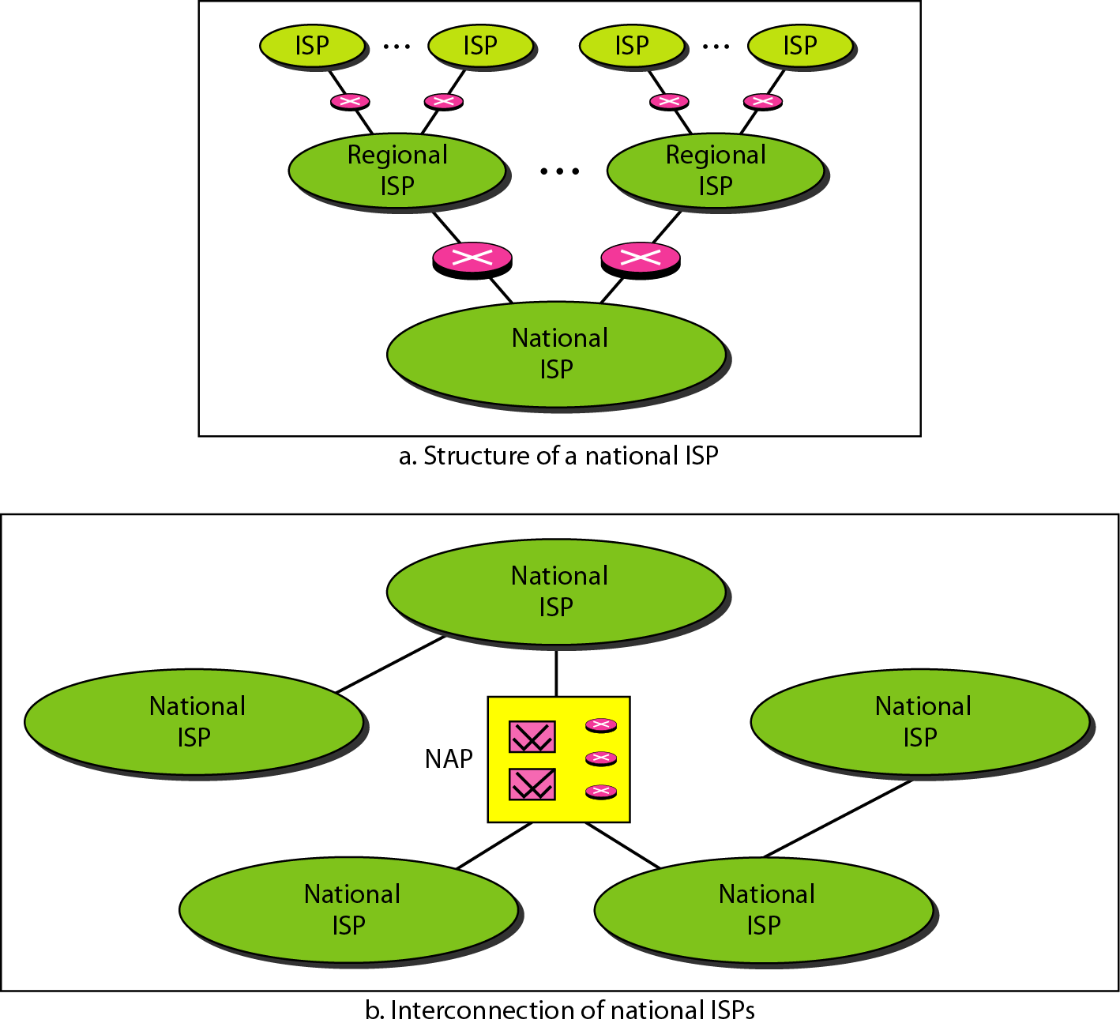
Internet Today
Figure 1.13 Hierarchical organization of the Internet

Slide 39
1-4 PROTOCOLS AND STANDARDS
In this section, we define two widely used terms: protocols and standards. First, we define protocol, which is synonymous with rule. Then we discuss standards, which are agreed-upon rules.
Topics discussed in this section:
Protocols Standards
Standards Organizations Internet Standards

Slide 40
Protocols and Standard
Communication in computer networks
Communication occurs between entities in different systems
Entity
is anything capable of sending or receiving information
Protocol
is a set of rules that govern data communication

Slide 41
Protocol & Standards (cont’d)
Key elements of a Protocol
Syntax
refers to the structure or format of the data, meaning the order in which they are presented.
Semantics
refers to the meaning of each section of bits.
Timing
refers to two characteristics (when data should be sent and how fast it can be sent)

Slide 42
Standards
Standards
are essential in creating and maintaining an open and competitive market for equipment manufactures and in guaranteeing national and international interoperability of data and communications technology and processes.
Standards
De facto
(by fact)
De jure
(by law)

Slide 43
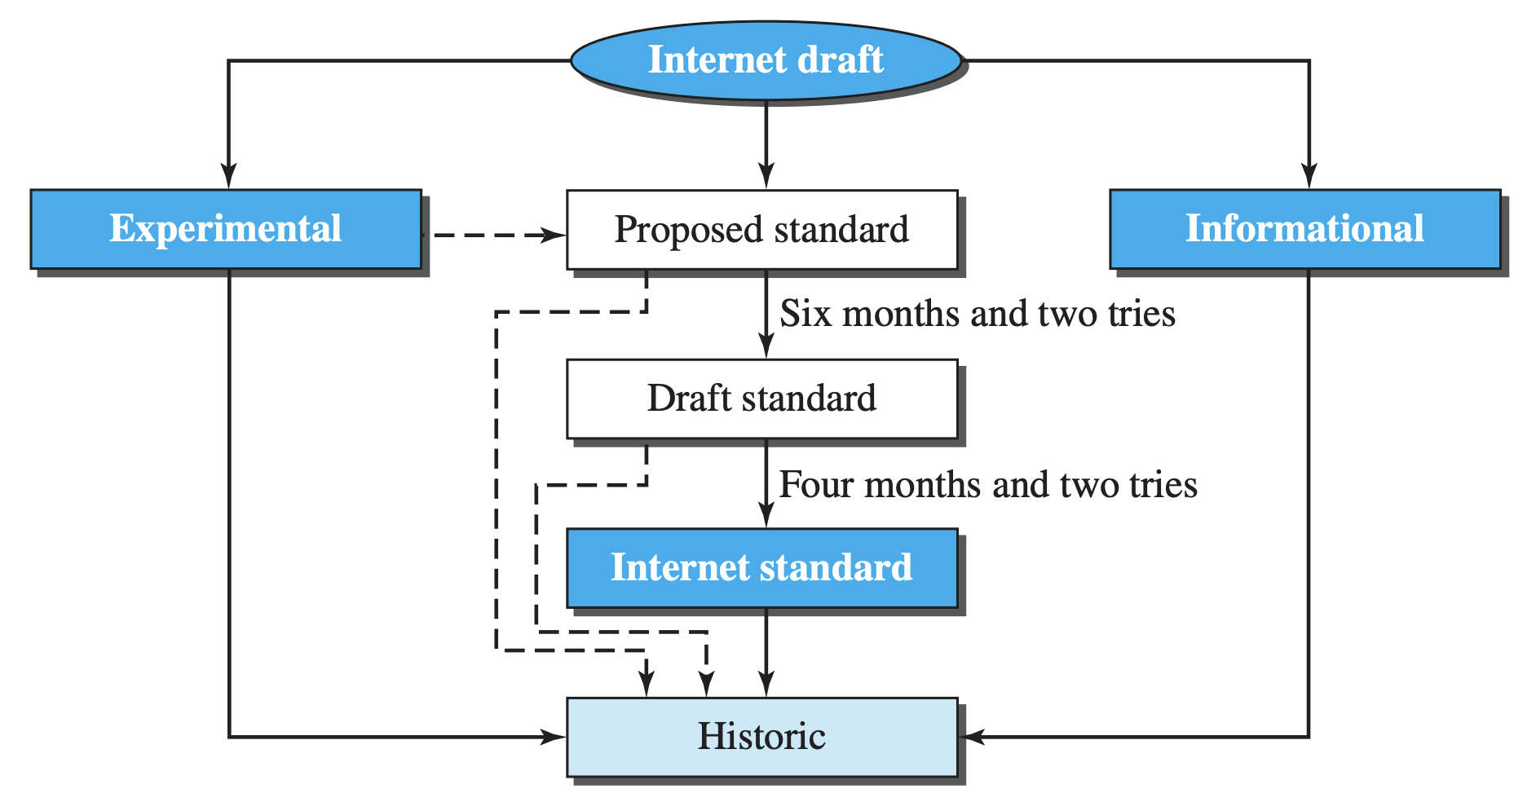
Internet Standard
An Internet standard is a thoroughly tested specification.
Figure 1.16 Maturity levels of an RFC

Slide 44
Requirement Levels of RFC
Five Requirement Level
Required
Must be implemented to achieve minimum conformance. (IP, ICMP)
Recommended
Not a must but recommended as it is useful (FTP, TELNET)
Elective
not required and not recommended. (TFTP)
Limited Use
Only in limited situation (all experimental RFCs)
Not Recommended
inappropriate for general use (historic (deprecated) RFC)

Slide 45
Standards Organizations
Standard Creation Committees
ISO (The International Standard Organization)
created in 1947
Multi national body
is an organization dedicated to worldwide agreement on international standards in a variety of fields (scientific, technological, economic activity)

Slide 46
Standards Organizations (cont’d)
ITU-T(International Telecommunications Union - Telecommunications Standards Sector)
is an international standards organization related to the United Nations that develops standards for telecommunications.
Two popular standards developed by ITU-T are the V series (data transmission over phone lines) and the X series (transmission over public digital networks)

Slide 47
Standards Organizations (cont’d)
ANSI (American National Standard Institute)
is a nonprofit organization and is the U.S. voting representative to be both the ISO and the ITU-T
IEEE (Institute of Electrical and Electronic Engineers)
is the largest national professional group involved in developing standards for computing, communication, electrical engineering, and electronics)
EIA (Electronic Industries Association)
is an association of electronics manufactures in the United States. (EIA-232-D, EIA-530 standards)

Slide 48
Standards Organizations (cont’d)
Forums
consist of representatives from corporation that test, evaluate and standardize new technologies.
Frame Relay Forum
ATM Forum and ATM consortium
Regulatory agencies
FCC (Federal Communications Commission)

Slide 49
Internet Standards
Internet standard by IETF (Internet Engineering Task Force)
is a thoroughly tested specification that is useful to and adhered by those who work with the Internet
A specification begins as an Internet draft
Working document with no official status and six-month life-time
RFC (Request for Comment) Recommendation from Internet authorities

Slide 50
Standards (cont’d)
by law standard
~ are those that have been legislated by an officially recognized body.
by fact standard
~ are often established originally by manufactures seeking to define the functionality of a new product or technology.
proprietary (closed)
~ are those originally invented by a commercial organization as a basis for the operation of its products.
nonproprietary (open)
~ are those originally developed by group or committees that have passed them into the public domain.

Slide 51
Summary (1)
Data communications are the transfer of data from one device to another via some form of transmission medium.
A data communications system must transmit data to the correct destination in an accurate and timely manner.
The five components that make up a data communications system are the message, sender, receiver, medium, and protocol.
Text, numbers, images, audio, and video are different forms of information.
Data flow between two devices can occur in one of three ways: simplex, half-duplex, or full-duplex.
A network is a set of communication devices connected by media links.
In a point-to-point connection, two and only two devices are connected by a dedicated link. In a multipoint connection, three or more devices share a link.

Slide 52
Summary (2)
Topology refers to the physical or logical arrangement of a network. Devices may be arranged in a mesh, star, bus, or ring topology.
A network can be categorized as a local area network or a wide area network.
A LAN is a data communication system within a building, plant, or campus, or between nearby buildings.
A WAN is a data communication system spanning state, countries, or the whole world.
An internet is a network of networks.
The Internet is a collection of many separate networks.
There are local, regional, national, and international Internet service providers.

Slide 53
Summary (3)
A protocol is a set of rules that govern data communication; the key elements of a protocol are syntax, semantics, and timing.
Standards are necessary to ensure that products from different manufacturers can work together as expected.
The ISO, ITU-T, ANSI, IEEE, and EIA are some of the organizations involved in standards creation.
Forums are special-interest groups that quickly evaluate and standardize new technologies.
A Request for Comment (RFC) is an idea or concept that is a precursor to an Internet standard.

Slide 54
Q & A

